Slide 1
ALY 6015 Intermediate Analytics Cooperative Project:
Predict House Price of King County, WA
Group 5:
Sijiang Liu,
Gupta Divya,
Zeyu Hu,
Venkata Krishna Kaushik Burra

Slide 2
Introduction
Predictive Analytics is widely used in real life. When the outputs are numerical, we can use regression model.
In our project, we are trying to use multiple regression models to predict the house price based on the house’s attributes.
We are using R and python in the coding part.

Slide 3
Research Questions
What’s the relationship between price and square feet of the house in overall?
How many floors the house possess has higher unit price?(???)
Is it reliable to use regression models with the attributes of house itself to predict its price?
Which model is the best one with the highest accuracy of prediction？
Which feature affects the price most?

Slide 4
Description of the dataset
We’ve used the House Sales in King County, USA dataset from Kaggle. It has 19 house features plus the price and the id columns, along with 21613 observations.The description of each column is as follows:
Id (Numeric) - a notation for a house
Date (String) - Date house was sold
Price (Numeric) - Price is prediction target
Bedrooms (Numeric) - Number of Bedrooms/House
Bathrooms (Numeric) - Number of bathrooms/bedrooms
Sqft_living (Numeric) - square footage of the home
Sqft_lot (Numeric) - square footage of the lot
Floors (Numeric) - Total floors (levels) in house
waterfrontHouse (String) - which has a view to a waterfront
View (String) - Has been viewed

Slide 5
Description of the dataset (part two)
11. Condition (String) - How good the condition is ( Overall )
12. Grade (String) - overall grade given to the housing unit, based on King County grading system
13. Sqft_above (Numeric) - square footage of house apart from basement
14. Sqft_basement (Numeric) - square footage of the basement
15. Yr_built (Numeric) - Built Year
16. Yr_renovated(Numeric) - Year when house was renovated
17. Zipcode (Numeric) - zip
18. Lat (Numeric) - Latitude coordinate
19. Long (Numeric) - Longitude coordinate
20. Sqft_living15 (Numeric) - Living room area in 2015(implies-- some renovations)
21. Sqft_lot15 (Numeric) - lotSize area in 2015(implies-- some renovations)

Slide 6
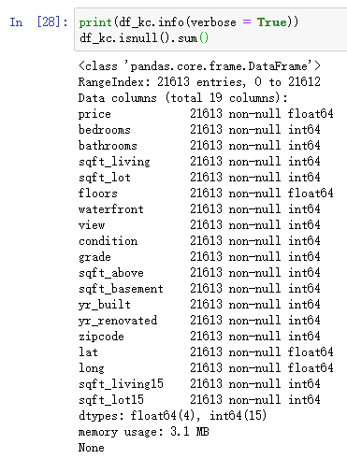
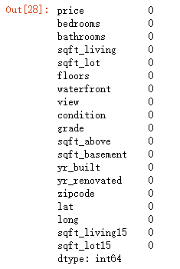
Data Preparation
Load the data and get its basic information.
Check if there is missing value.

Slide 7
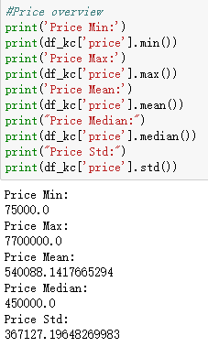
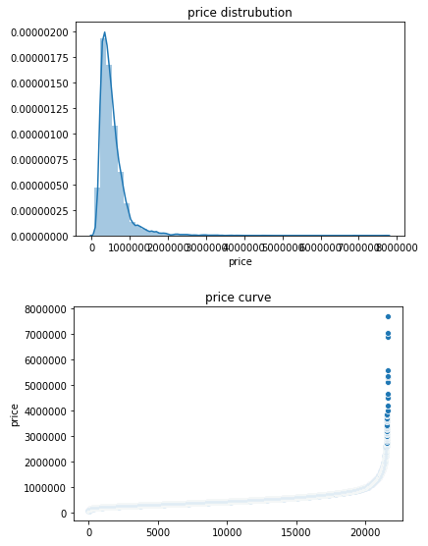
Information of Price (Can switch to R)

Slide 8
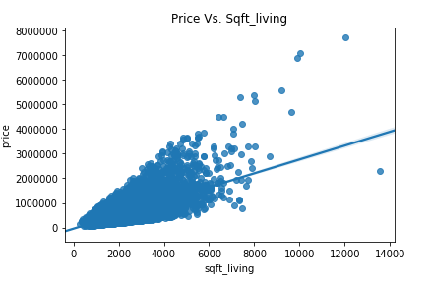
Price vs Square feet of home
We can find there exists linear relationship between price and the square feet of house.

Slide 9

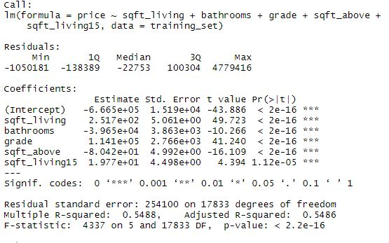
Linear Regression Model
We are splitting the training set and test set with 80% values in training set and 20% values in test set.
We are then building the model with taking the significant predictors only.

Slide 10
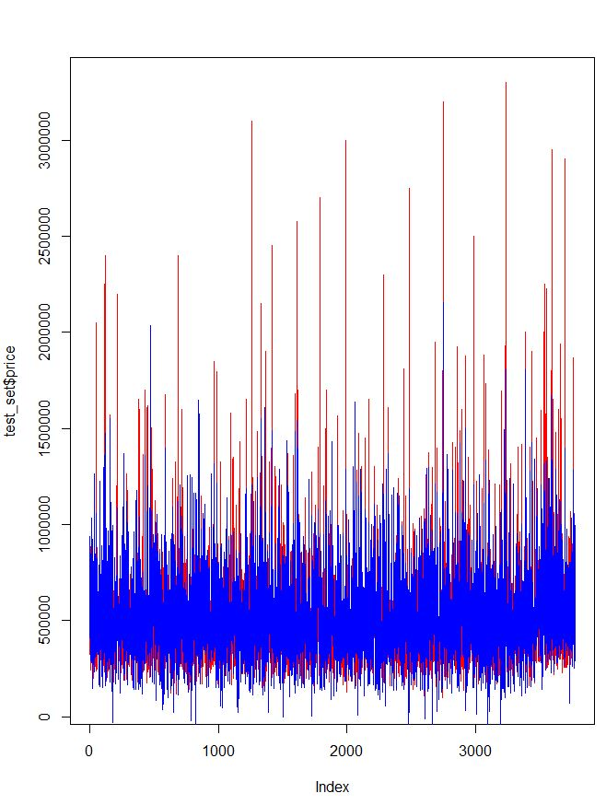
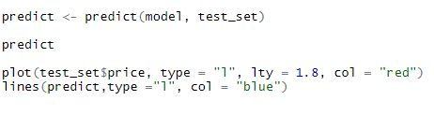
Predicting the model

Slide 11
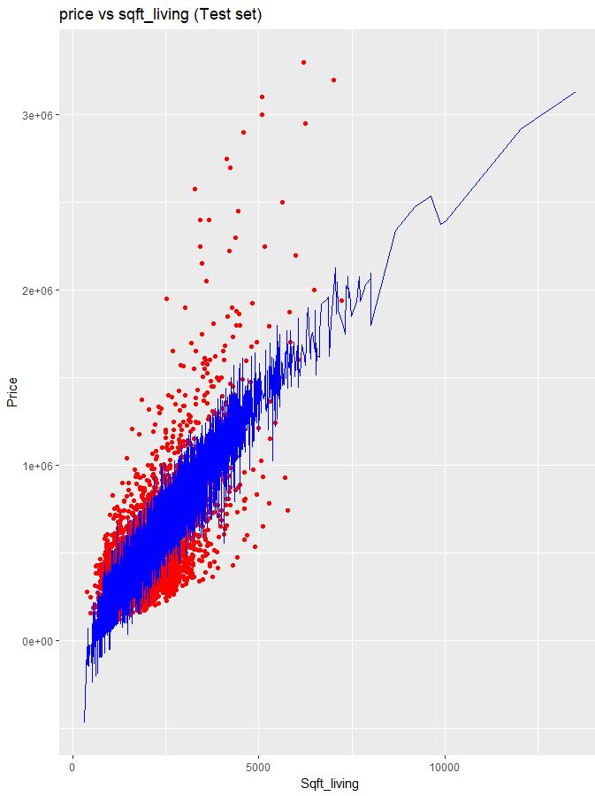
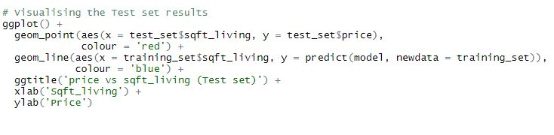
Predictions for Price vs Sqft Living

Slide 12
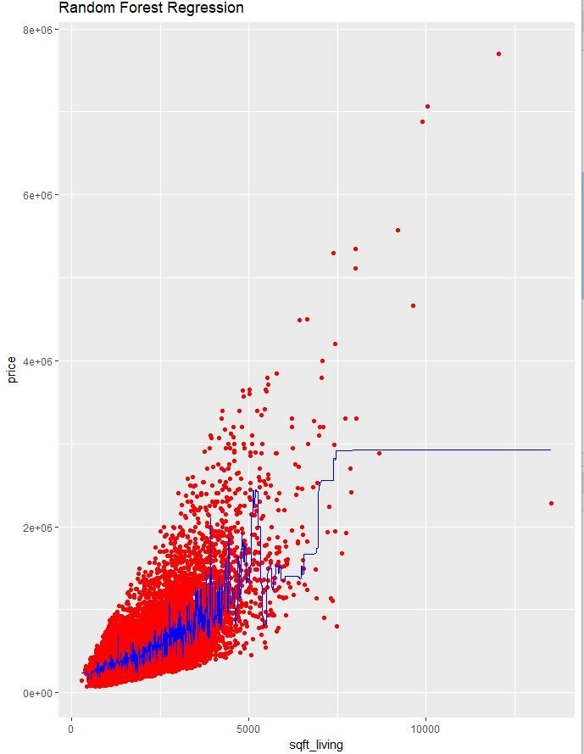
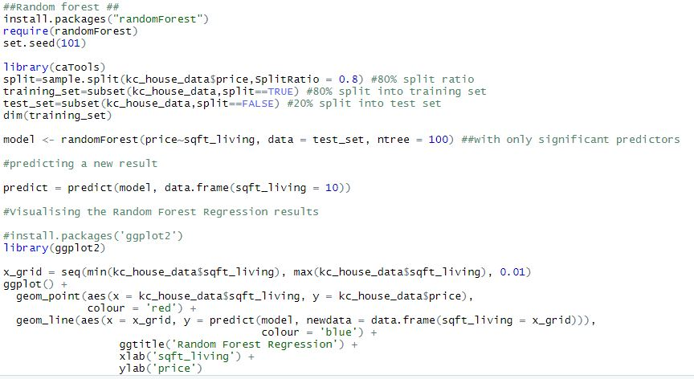
Random Forest Regression

Slide 13
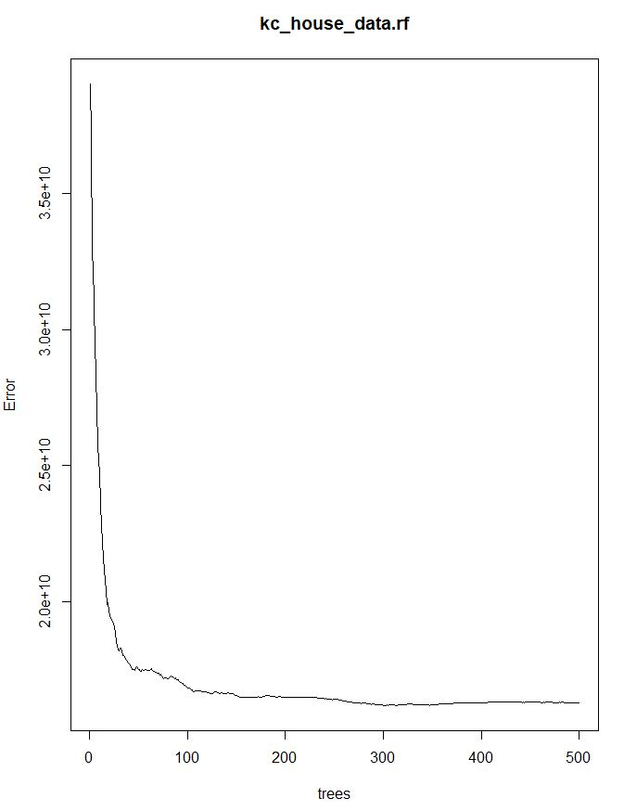
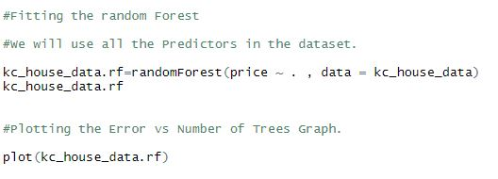
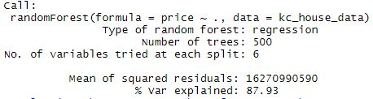
Error with respect to Number of Trees
The Error decreases significantly with the increase in the number of Trees.

Slide 14
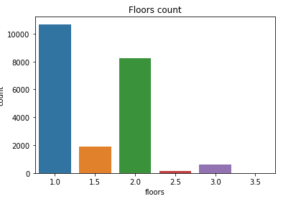
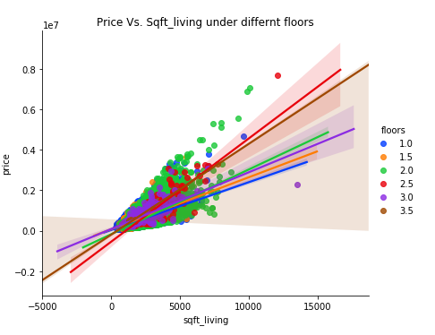
How the Number of floors affect the price

Slide 15
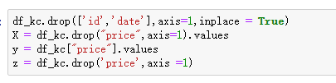
Fitting the model
Firstly, we drop the both the ‘id’ and ‘date’ column,

Slide 16
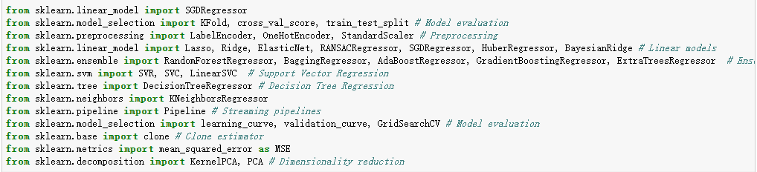
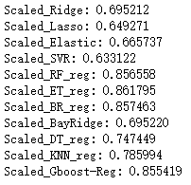
Model Selection
Since it’s a regression problem, we apply as many regression models as we can and streaming our models in pipeline to show their results together. We are using cross validation value as out come measures.

Slide 17
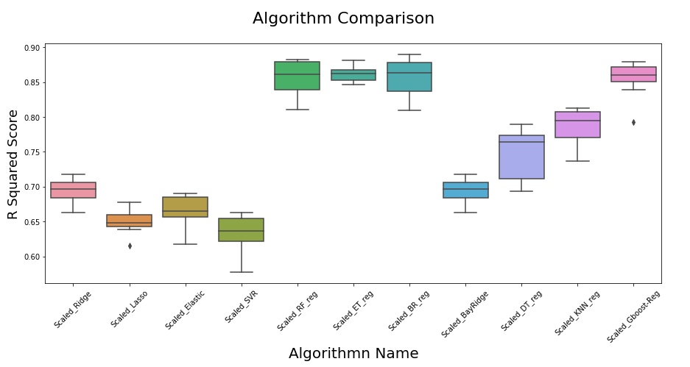
Analysis of the model

Slide 18
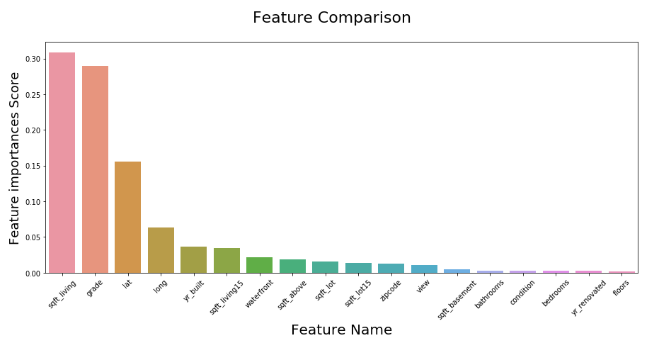
Feature Importance
We’ve found that random forest model has the highest score. We want to know among all of the features, which one affects the price most.

Slide 19
Conclusion
There is linear relationship between price and square feet of the house in overall?
Houses with 2 or 2.5 floors has higher unit price.
Random Forest, Extra Trees and Bagging these three regressors are reliable in this case.
Sqft_living is the most important feature in the Random Forest Model, and the cumulative importance of sqft_living, grade, lat and long is higher than 80%.

Slide 20
Reference
Kaggle. House Sales in King County, USA. Retrieve from https://www.kaggle.com/harlfoxem/housesalesprediction

